Slide 1
Machine Learning
MATH42815
Tuesday January 23rd 2024

Slide 2
Week 3
Practical 7:
CART algorithm
Lecture 5:
Pruning decision trees
Bootstrap, boosting, and bagging
Practicals 8 and 9:
Random forest
Lecture 6:
Neural Networks 1

Slide 3
Lecture 5 Outline
Gini Impurity: Revisited
Pruning your Decision Tree
A “New” Type of Error
The Bootstrap Method
Bagging
Boosting

Slide 4
Gini Impurity: Revisited

Slide 5
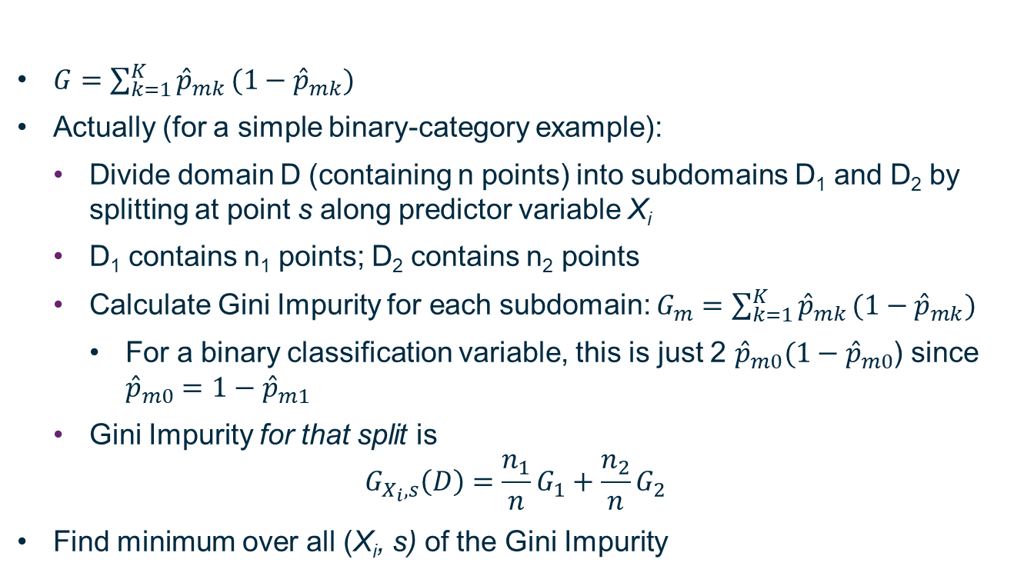
Gini Impurity
$G=\sum_{k=1}^{K}{{\hat{p}}_{mk}}(1−{\hat{p}}_{mk})$
Actually (for a simple binary-category example):
Divide domain D (containing n points) into subdomains D₁ and D₂ by splitting at point s along predictor variable X_{i}
D₁ contains n₁ points; D₂ contains n₂ points
Calculate Gini Impurity for each subdomain: $G_{m}=\sum_{k=1}^{K}{{\hat{p}}_{mk}}(1−{\hat{p}}_{mk})$
For a binary classification variable, this is just 2 ${\hat{p}}_{m0}(1−{\hat{p}}_{m0}$) since ${\hat{p}}_{m0}=1−{\hat{p}}_{m1}$
Gini Impurity for that split is
$$G_{X_{i},s}\left(D\right)=\frac{n_{1}}{n}G_{1}+\frac{n_{2}}{n}G_{2}$$
Find minimum over all (X_{i}, s) of the Gini Impurity

Slide 6
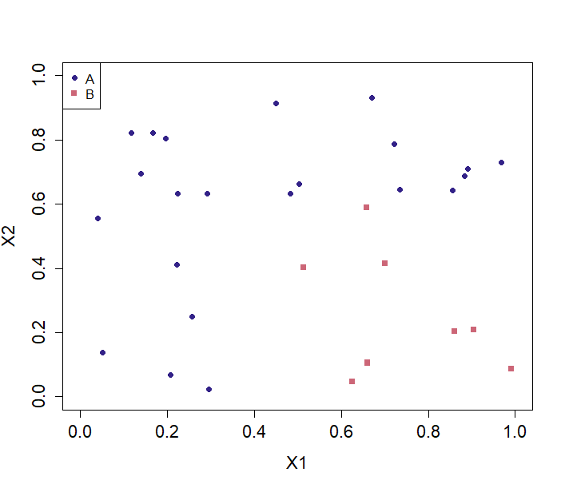
Simple Binary Example

Slide 7
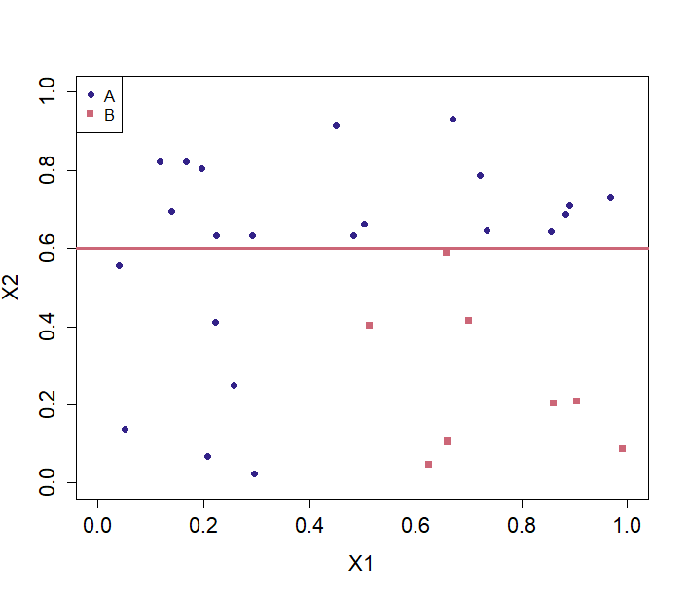
Horizontal Split?

Slide 8

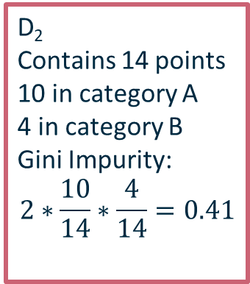
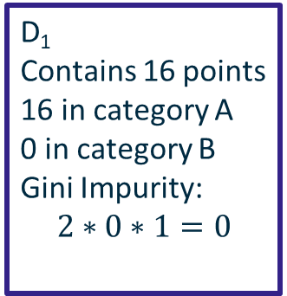
Horizontal Split?
D₁
Contains 16 points
16 in category A
0 in category B
Gini Impurity:
$$2∗0∗1=0$$
D₂
Contains 14 points
10 in category A
4 in category B
Gini Impurity:
$$2∗\frac{10}{14}∗\frac{4}{14}=0.41$$
Total Gini Impurity: $\frac{16}{30}∗0+\frac{14}{30}∗0.41=0.19$

Slide 9
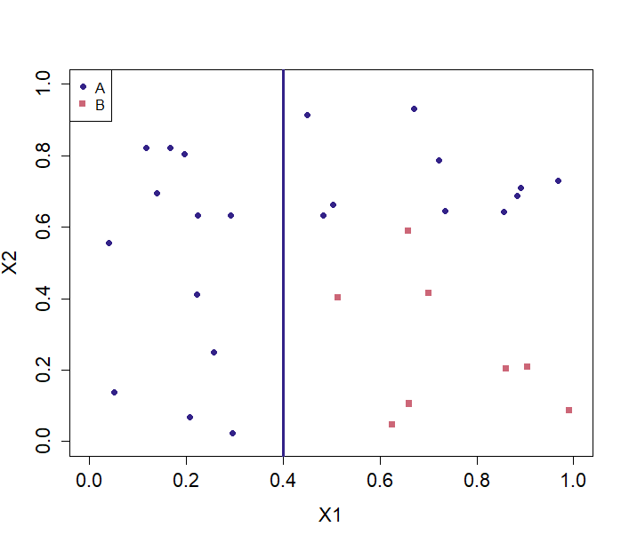
Vertical Split?

Slide 10

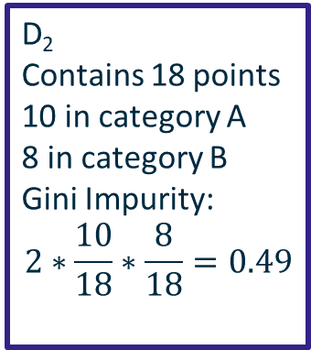

Vertical Split?
D₁
Contains 12 points
12 in category A
0 in category B
Gini Impurity:
$$2∗0∗1=0$$
D₂
Contains 18 points
10 in category A
8 in category B
Gini Impurity:
$$2∗\frac{10}{18}∗\frac{8}{18}=0.49$$
Total Gini Impurity: $\frac{12}{30}∗0+\frac{18}{30}∗0.49=0.296$

Slide 11



Compare Gini Impurities: Greedy Top-Down Algorithm
Null Gini Impurity: $\frac{30}{30}\left(2∗\frac{22}{30}∗\frac{8}{30}\right)=0.391$
Vertical Split: $\frac{12}{30}∗0+\frac{18}{30}∗0.49=0.296$
Horizontal Split: $\frac{16}{30}∗0+\frac{14}{30}∗0.41=0.19$
As with forward subset selection: not guaranteed to get “best” split in final tree,
but tradeoff in terms of computational cost worth it.

Slide 12
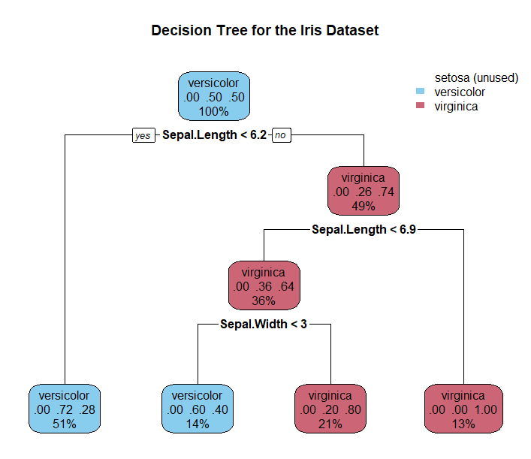
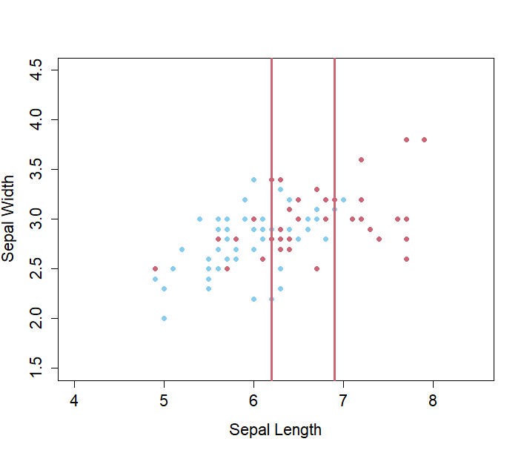
Split 2

Slide 13
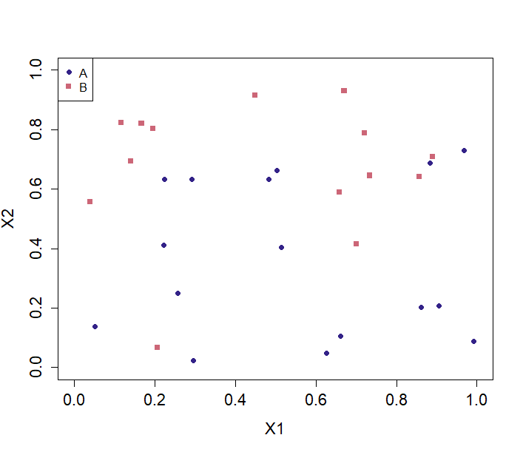
Less Organised Data

Slide 14
Pruning Your Decision Tree

Slide 15
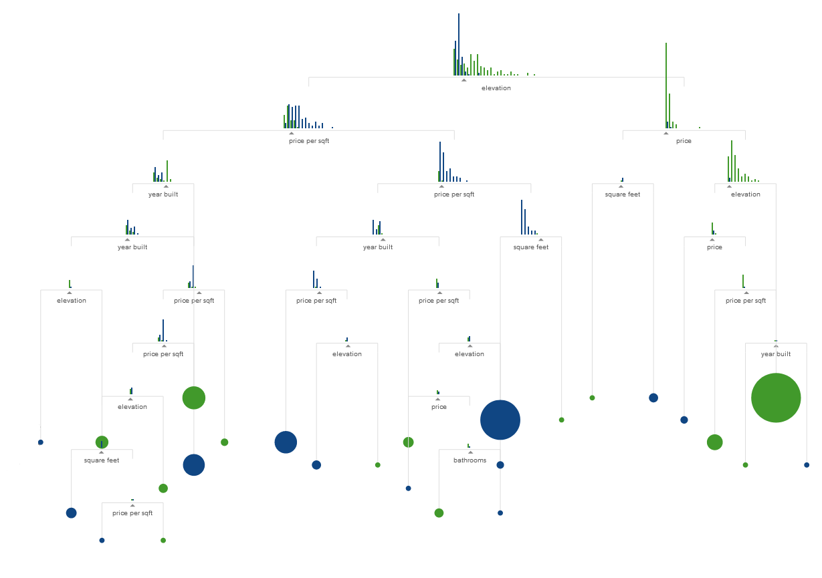
Step 1: Make the Biggest Tree using training data, called T₀
http://www.r2d3.us/visual-intro-to-machine-learning-part-1/

Slide 16
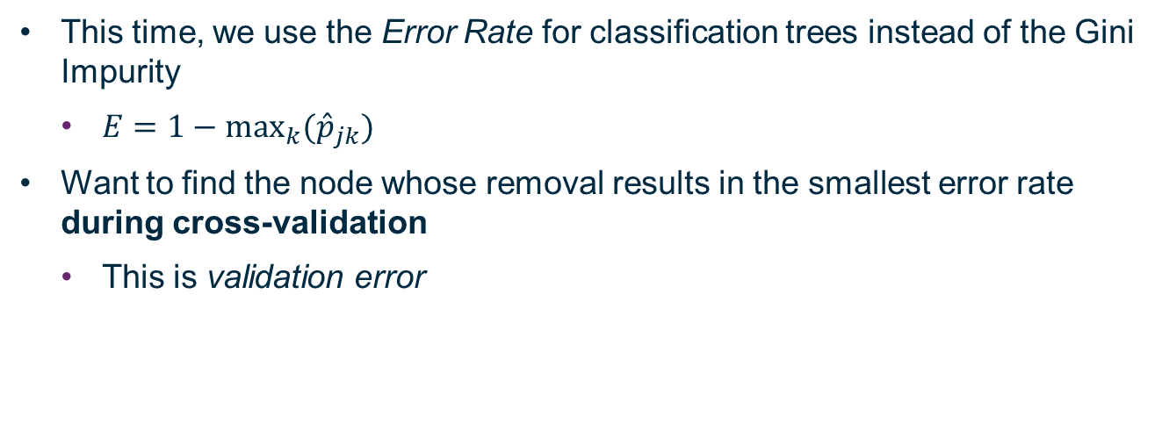
Step 2: Remove one node at a time and see what the impact on tree purity is for test data set
This time, we use the Error Rate for classification trees instead of the Gini Impurity
$E=1−\max_{k}({\hat{p}}_{jk})$
Want to find the node whose removal results in the smallest error rate during cross-validation
This is validation error

Slide 17
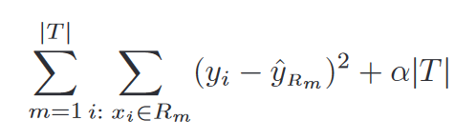
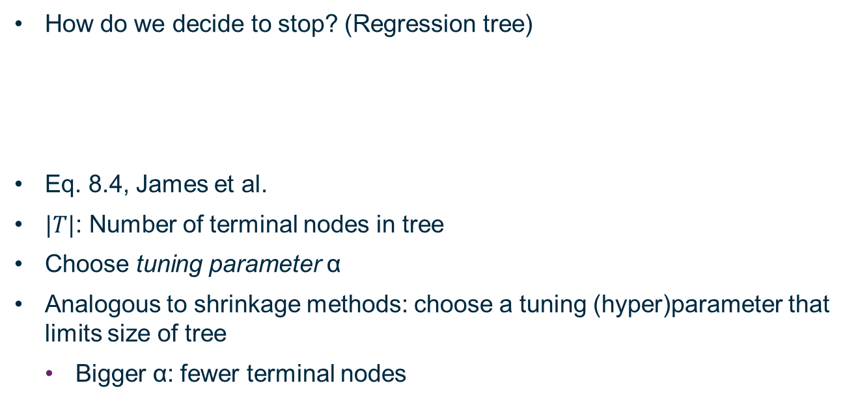
Step 3: Keep doing this until we decide to stop
How do we decide to stop? (Regression tree)
Eq. 8.4, James et al.
$|T|$: Number of terminal nodes in tree
Choose tuning parameter α
Analogous to shrinkage methods: choose a tuning (hyper)parameter that limits size of tree
Bigger α: fewer terminal nodes
For classification tree: Error rate, not MSE

Slide 18
New Type of Error

Slide 19
Training, Validation, Test
We have largely referred to training and test error so far in this course
Training: Create a model which fits data set as closely as possible
Choosing model parameters (coefficients)
Validation: Improve the form of the model by testing whether it can reproduce data it wasn’t trained on with a suitable level of accuracy
Choosing model hyperparameters (e.g. number of feature variables)
Includes cross-validation techniques
Test: Determine how the final model performs using completely new and independent data

Slide 20
Bootstrap

Slide 21
Improving Estimates Through Resampling
In ISDS, learned about statistics of populations
e.g. mean of population
Can be estimated based on samples of observations
Suppose we have a sample of n observations, and no way to make further observations
We can improve our estimate of the true value of a statistic by resampling with replacement from our existing sample

Slide 22
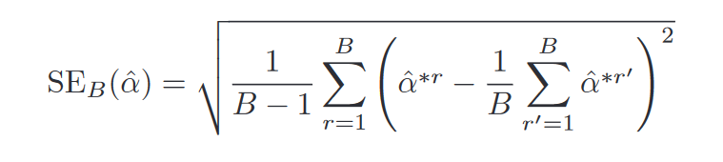
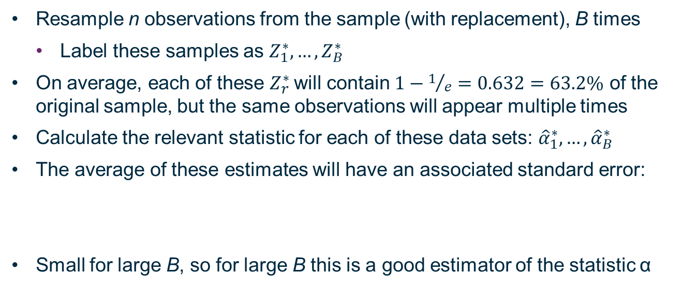
Bootstrap Method
Resample n observations from the sample (with replacement), B times
Label these samples as $Z_{1}^{∗},…,Z_{B}^{∗}$
On average, each of these $Z_{r}^{∗}$will contain $1−1/e=0.632=63.2\%$ of the original sample, but the same observations will appear multiple times
Calculate the relevant statistic for each of these data sets: ${\hat{α}}_{1}^{∗},…,{\hat{α}}_{B}^{∗}$
The average of these estimates will have an associated standard error:
Small for large B, so for large B this is a good estimator of the statistic α

Slide 23
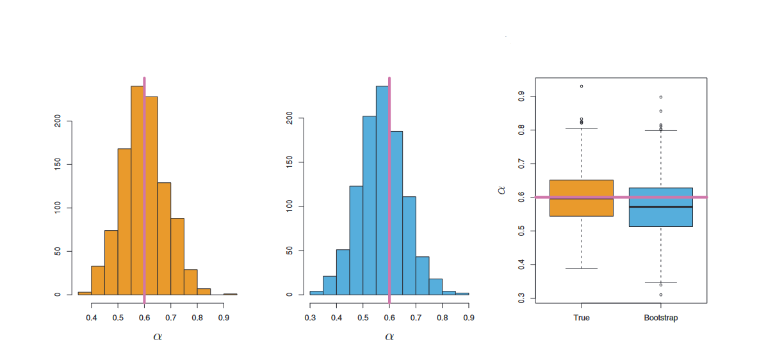
Orange: B samples from true population Blue: B resamples from initial sample
Figure 5.10, James et al. (2013)
For more detail, see Section 5.2 of James et al. (2013)

Slide 24
Bagging

Slide 25
Step 1: Make the Biggest Tree using training data, called T₀
http://www.r2d3.us/visual-intro-to-machine-learning-part-1/

Slide 26
Bagging = Bootstrap AGGregation
Deeper nodes of CART tend to exhibit a lot of variance in where optimal slice occurs
Results in many different predicted outcomes for new, non-training data
Same training data will always have same “full tree” split, but test data most likely to go wrong in terminal nodes
How to resolve this?
BOOTSTRAP
Resample with replacement from our n observations, B times
Build B trees based on these new samples
Deep trees, no pruning – high variance in terminal nodes

Slide 27
Less Organised Data

Slide 28
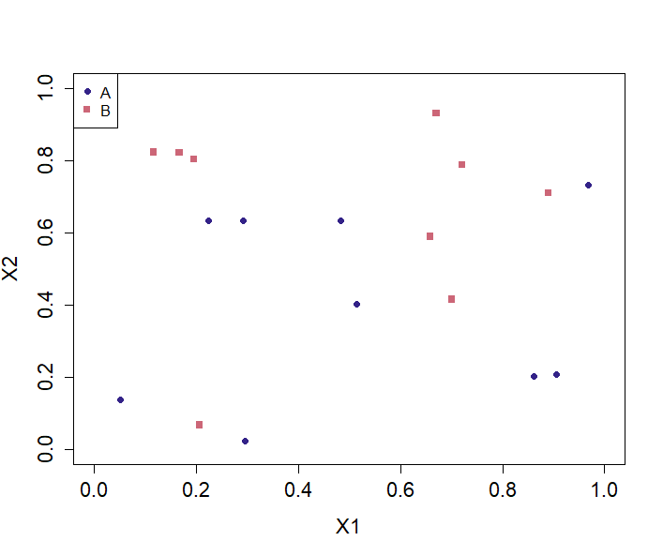
Bootstrap selection

Slide 29
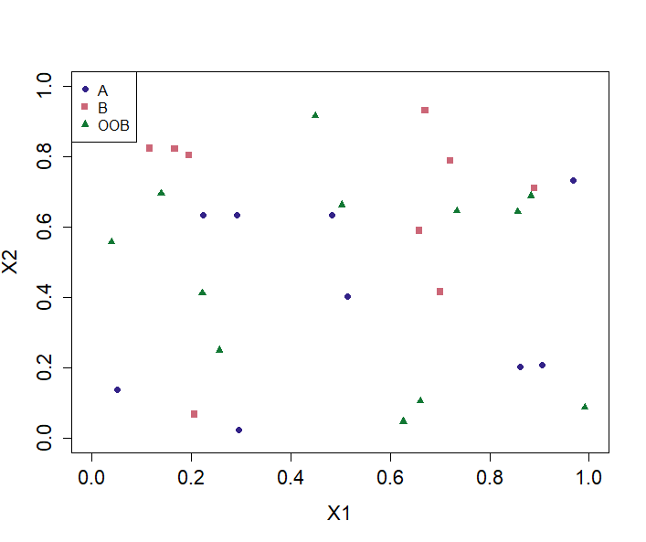
Out-of-Bag Data (In-built validation data)

Slide 30
“Deep, Unpruned” Decision Tree

Slide 31
Out-of-Bag Data (In-built validation data)

Slide 32
Less Organised Data

Slide 33
Out-Of-Bag Error Estimation
Remember: each resample contains on average 63.2% of the original sample
Specific observations repeated to obtain same number of observations as original sample
K-fold cross validation: Keep n/K observations as test set
Bagging: Specific data point appears in 63.2% of resampled data sets
“Out-Of-Bag” error
Classification tree: Point classified as most common in-bag class
Regression tree: Point assigned mean value between all in-bag trees
“Out-Of-Bag” prediction used for validation of “In-Bag” tree

Slide 34
Disadvantages
Final output not really a “tree”
Harder to interpret
Need to rely on computer to do predictions of new data
Higher computational cost since need to fit B trees instead of just 1

Slide 35
Random Forests

Slide 36
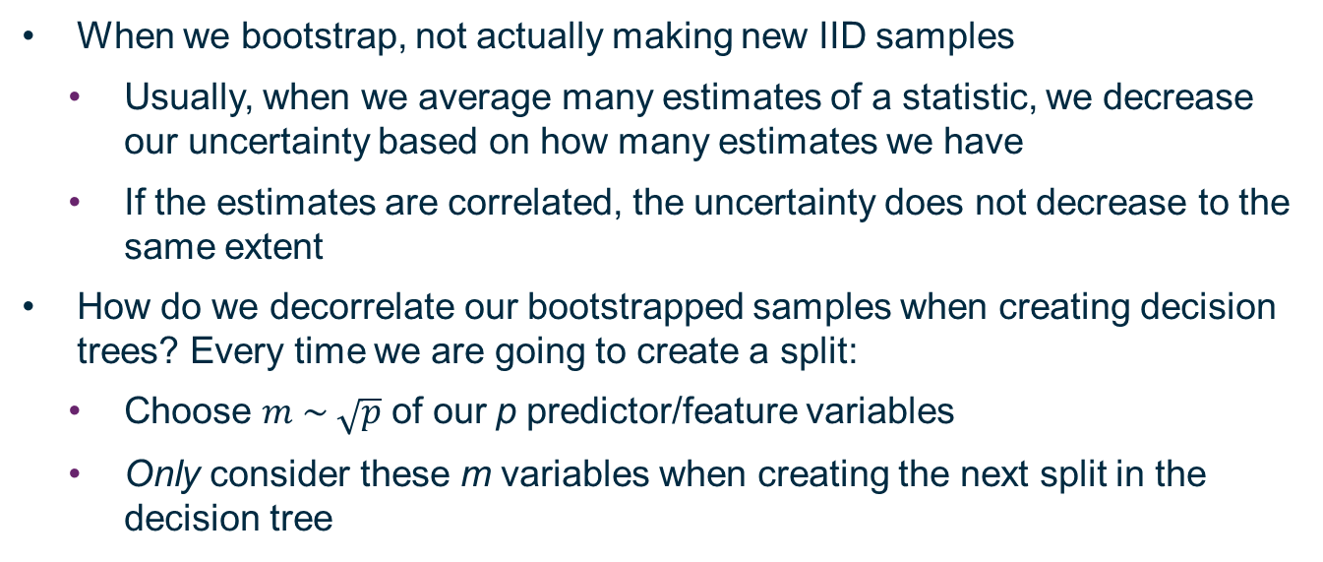
Issue with Bagging: Correlation
When we bootstrap, not actually making new IID samples
Usually, when we average many estimates of a statistic, we decrease our uncertainty based on how many estimates we have
If the estimates are correlated, the uncertainty does not decrease to the same extent
How do we decorrelate our bootstrapped samples when creating decision trees? Every time we are going to create a split:
Choose $m \sim \sqrt{p}$ of our p predictor/feature variables
Only consider these m variables when creating the next split in the decision tree

Slide 37
Random Forest: Justification
If one feature variable dominates over others, splits will tend to occur along this variable
Behaviour of resulting trees will therefore correlate
If other variables are still important, bagging may downplay their contribution due to the correlation driven by the dominant feature
If only a subset of feature/predictor variables are available as an option for a given split, and the dominant feature is not among them, the next decision boundary cannot be driven by the dominant feature
Since random subset of features/predictors chosen for each split, dominant feature not entirely neglected, but an opportunity is created for other variables to contribute

Slide 38
Boosting

Slide 39
Boosting
Kind of like a cross between bagging and gradient descent
Easier to explain for regression trees
Still works for classification trees but harder to write out algorithm

Slide 40
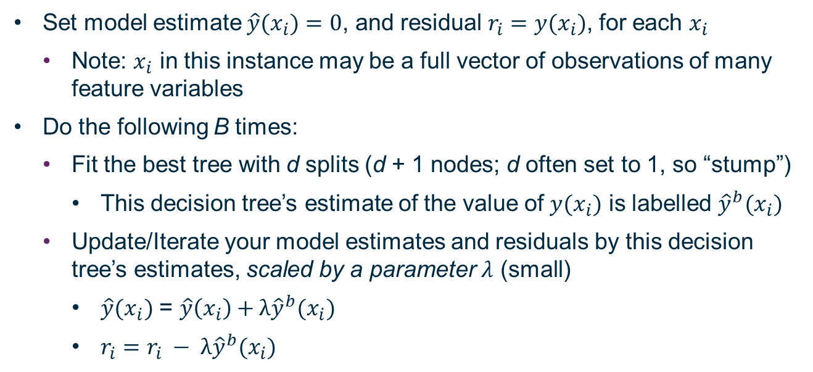
Boosting Algorithm for Regression Trees
Set model estimate $\hat{y}(x_{i})=0$, and residual $r_{i}=$ $y(x_{i})$, for each $x_{i}$
Note: $x_{i}$ in this instance may be a full vector of observations of many feature variables
Do the following B times:
Fit the best tree with d splits (d + 1 nodes; d often set to 1, so “stump”)
This decision tree’s estimate of the value of $y(x_{i})$ is labelled ${\hat{y}}^{b}(x_{i})$
Update/Iterate your model estimates and residuals by this decision tree’s estimates, scaled by a parameter $λ$ (small)
$\hat{y}(x_{i})$ = $\hat{y}\left(x_{i}\right)+λ{\hat{y}}^{b}(x_{i})$
$r_{i}=r_{i} − λ{\hat{y}}^{b}(x_{i})$

Slide 41
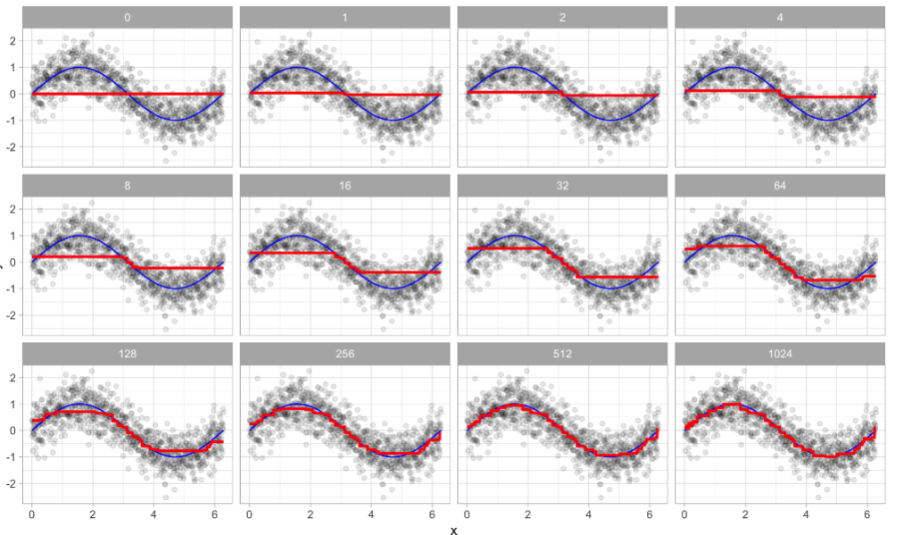
One-Dimensional Example
https://bradleyboehmke.github.io/HOML/gbm.html

Slide 42
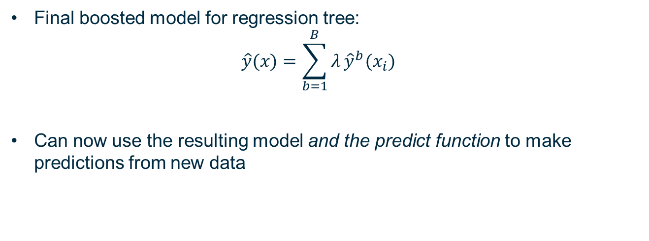
Gradually Recreate Training Data
Final boosted model for regression tree:
$$\hat{y}(x)=\sum_{b=1}^{B}{λ}{\hat{y}}^{b}(x_{i})$$
Can now use the resulting model and the predict function to make predictions from new data

Slide 43
Well-Tuned Boosted Models Hard To Beat
Although the concept is relatively straightforward, boosted models have taken the lead in many AI competitions
Tuning the model is key
Good tuning is a result of understanding your data and experience

Slide 44
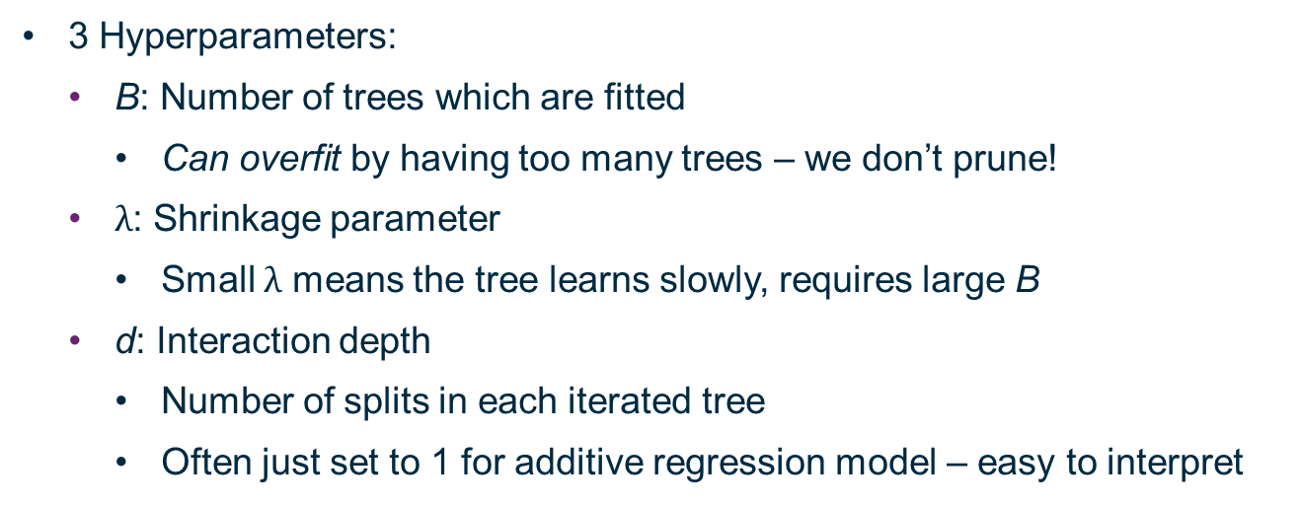
“Tuning” the Boosted Model
3 Hyperparameters:
B: Number of trees which are fitted
Can overfit by having too many trees – we don’t prune!
$λ$: Shrinkage parameter
Small $λ$ means the tree learns slowly, requires large B
d: Interaction depth
Number of splits in each iterated tree
Often just set to 1 for additive regression model – easy to interpret

Slide 45
Summary

Slide 46
Summary
Gini Impurity
How to Prune a Decision Tree
Explicitly mentioned validation error (vs. training, testing)
Bootstrap – resampling to improve estimates of statistics
Bagging – aggregating the results of bootstraps to create better “trees”
Random Forests – deaggregate your bagged, resampled data sets
Boosting – get the best final product by incremental improvements

